Slide 1

Jue Wang, Xinpei Li, Suyuan Liu

Slide 2
Class Hierarchy
QObject
QWidget
QMainWindow
Game
GameInstruction
GameLevel
grade
GradeChoice
MainWindow
result
card

Slide 3
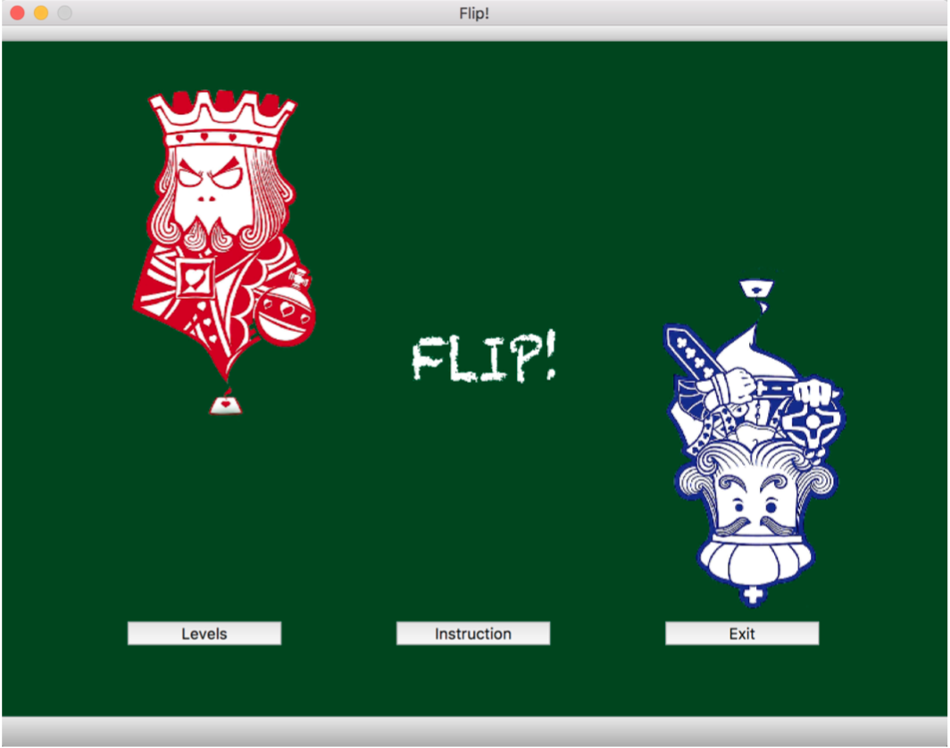
Class: MainWindow
QMainWindow
Game
GameInstruction
GameLevel
grade
GradeChoice
MainWindow
result

Slide 4
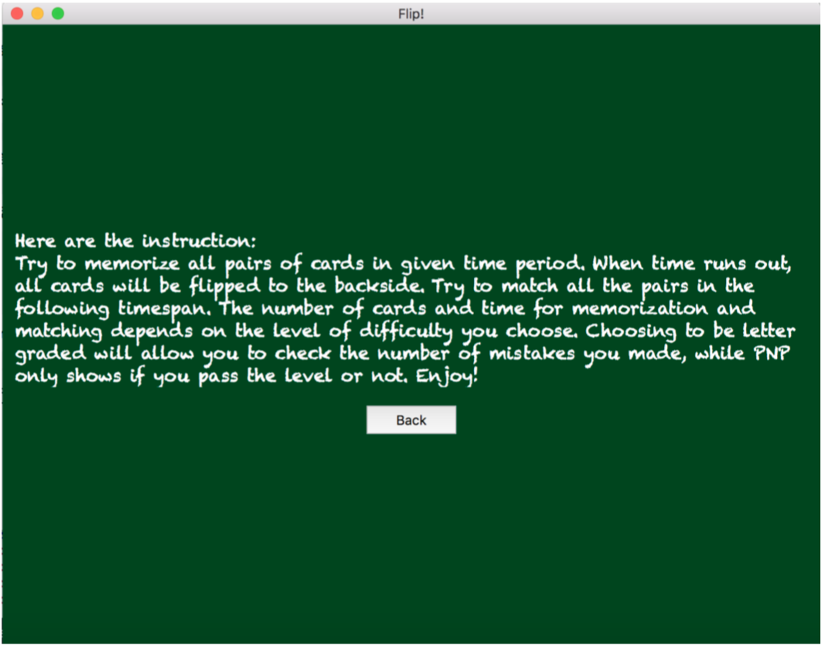
Class: GameInstruction
QMainWindow
Game
GameInstruction
GameLevel
grade
GradeChoice
MainWindow
result

Slide 5
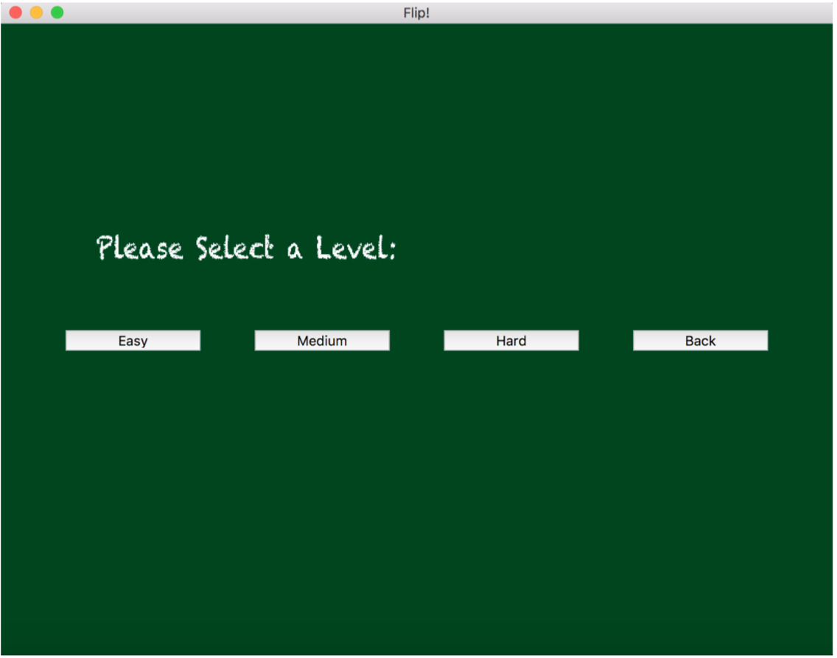
Class: GameLevel
QMainWindow
Game
GameInstruction
GameLevel
grade
GradeChoice
MainWindow
result

Slide 6
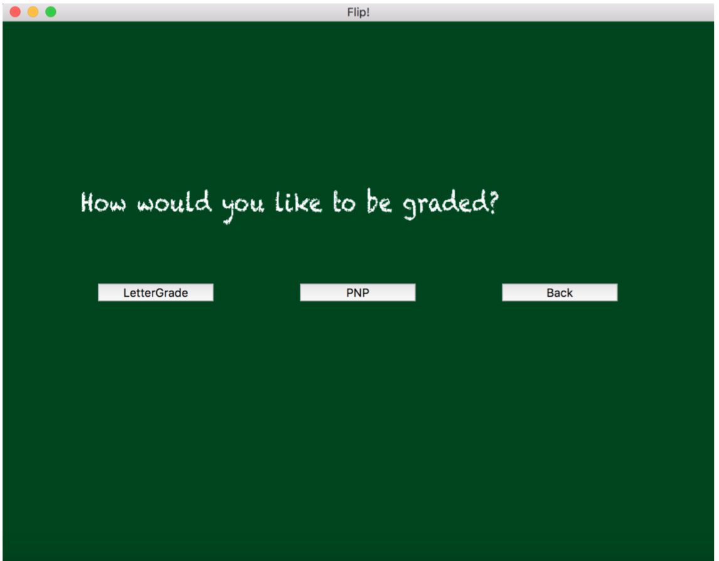
Class: GradeChoice
QMainWindow
Game
GameInstruction
GameLevel
grade
GradeChoice
MainWindow
result

Slide 7
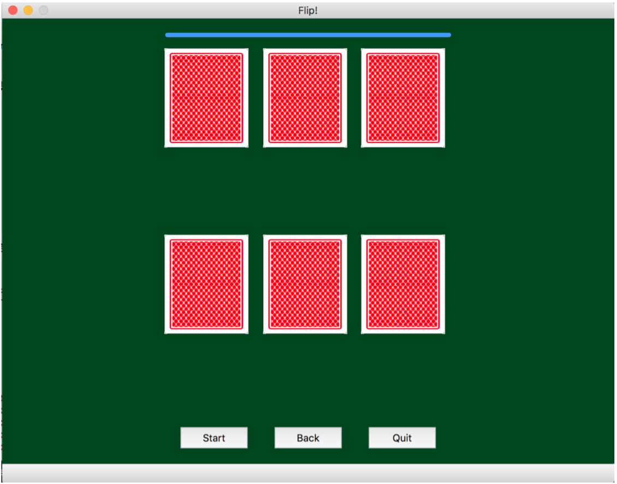
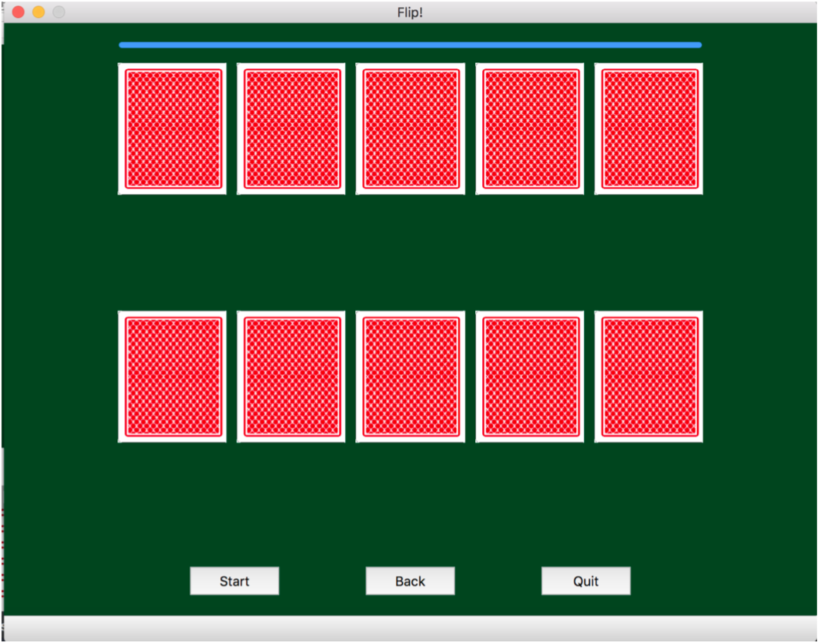
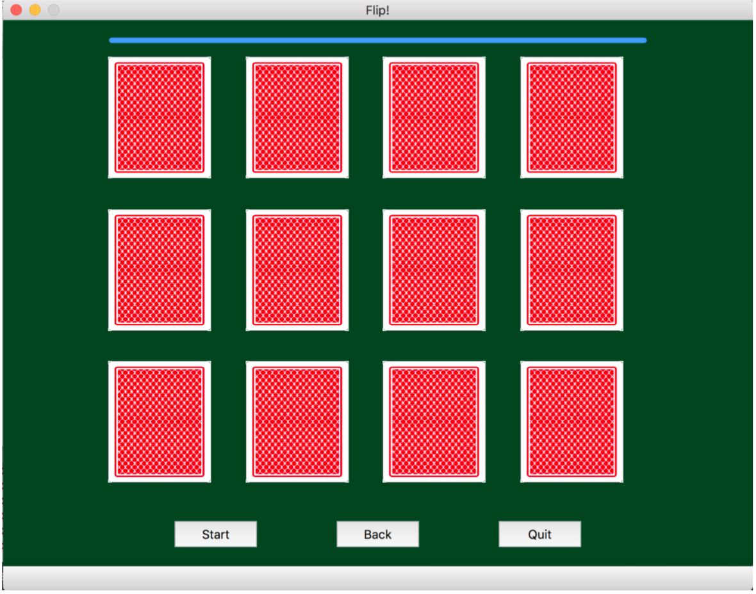
Class: Game
Layouts are dynamically allocated depending on levels

Slide 8
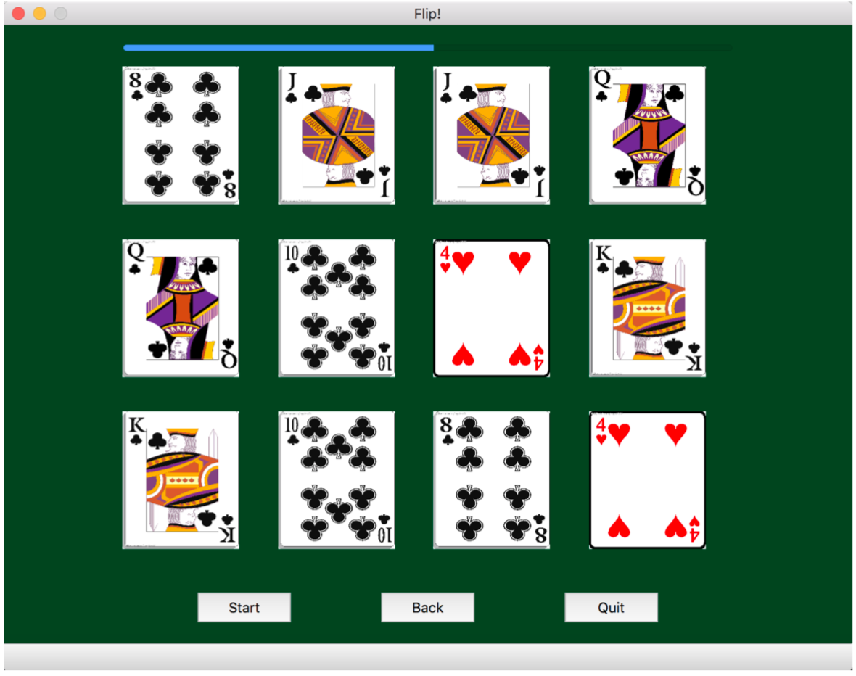
Step 1: Memorize Cards’ Placement

Slide 9
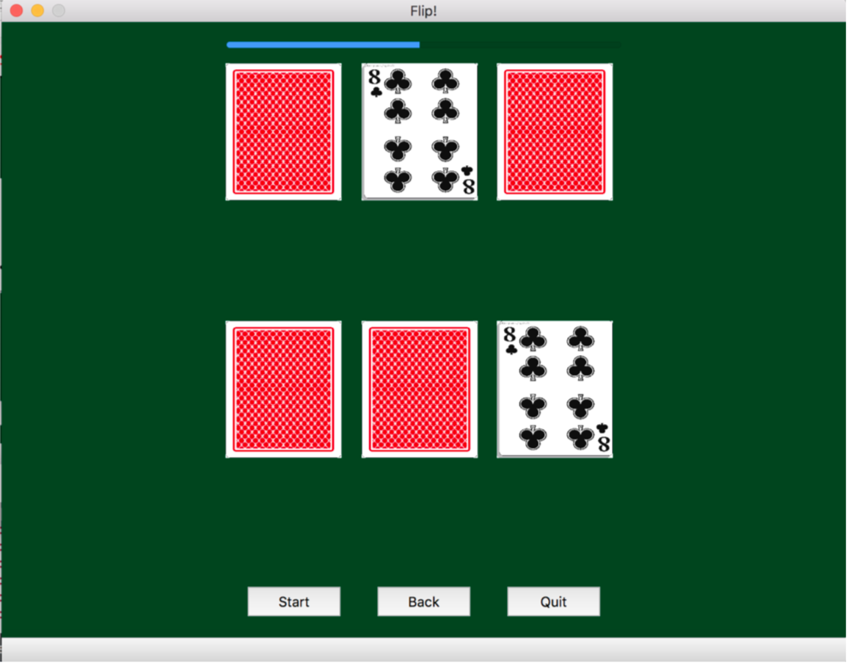
Step 2: Choosing cards to eliminate

Slide 10
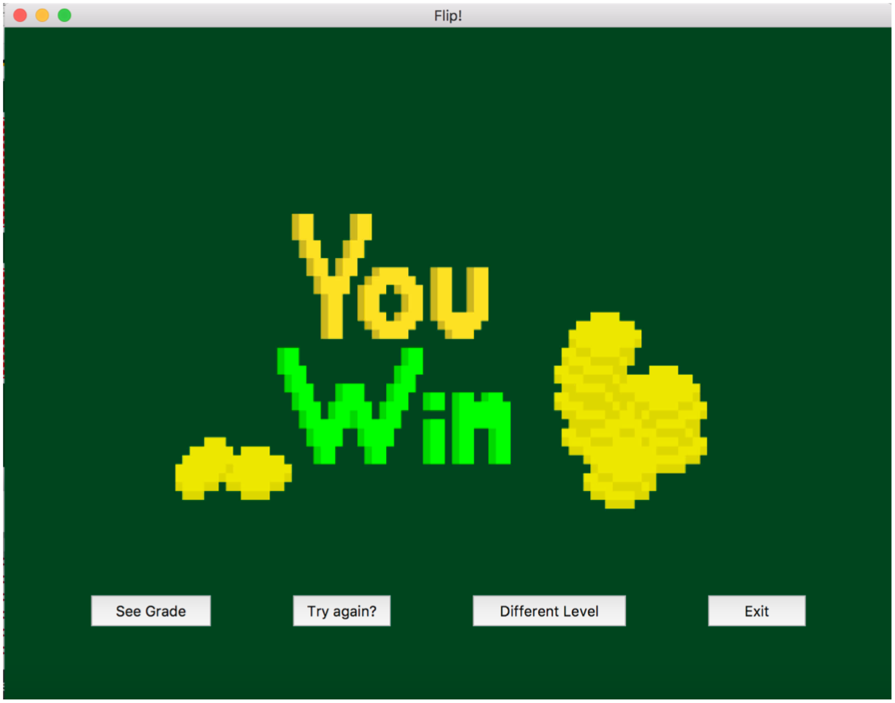
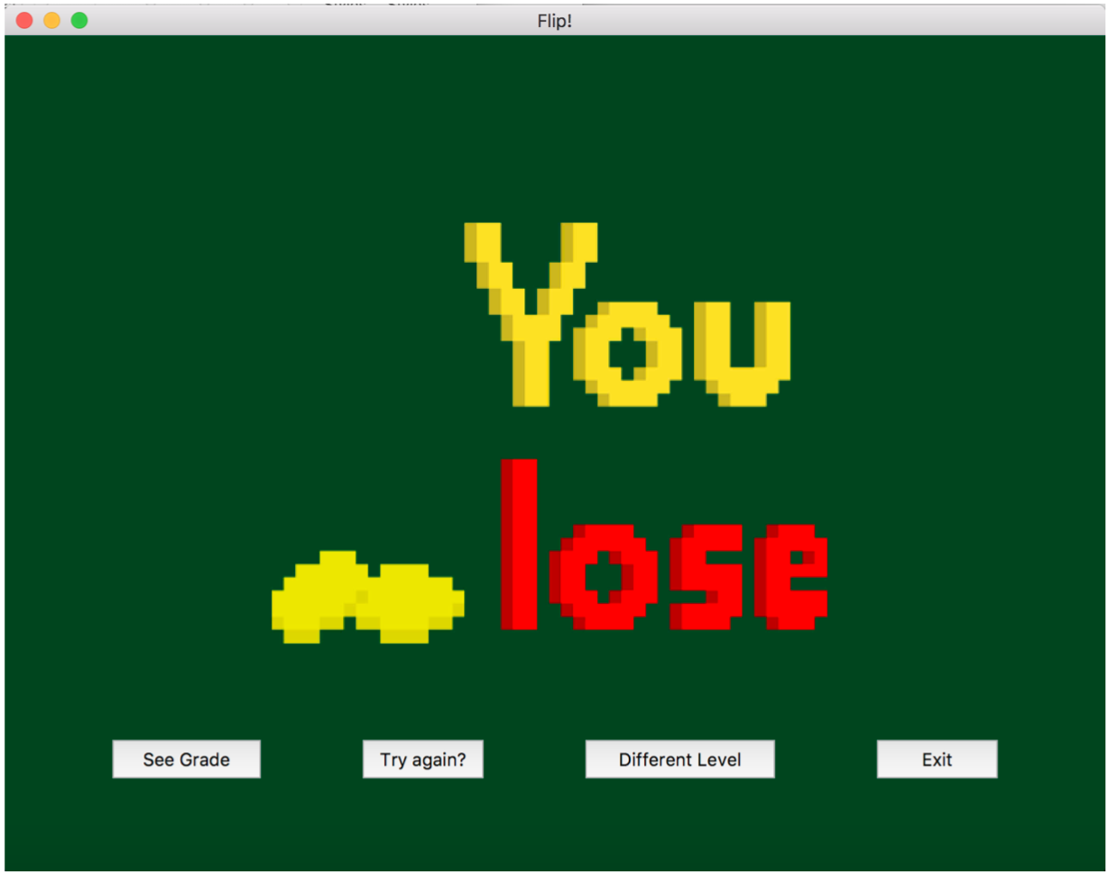
Class: result

Slide 11
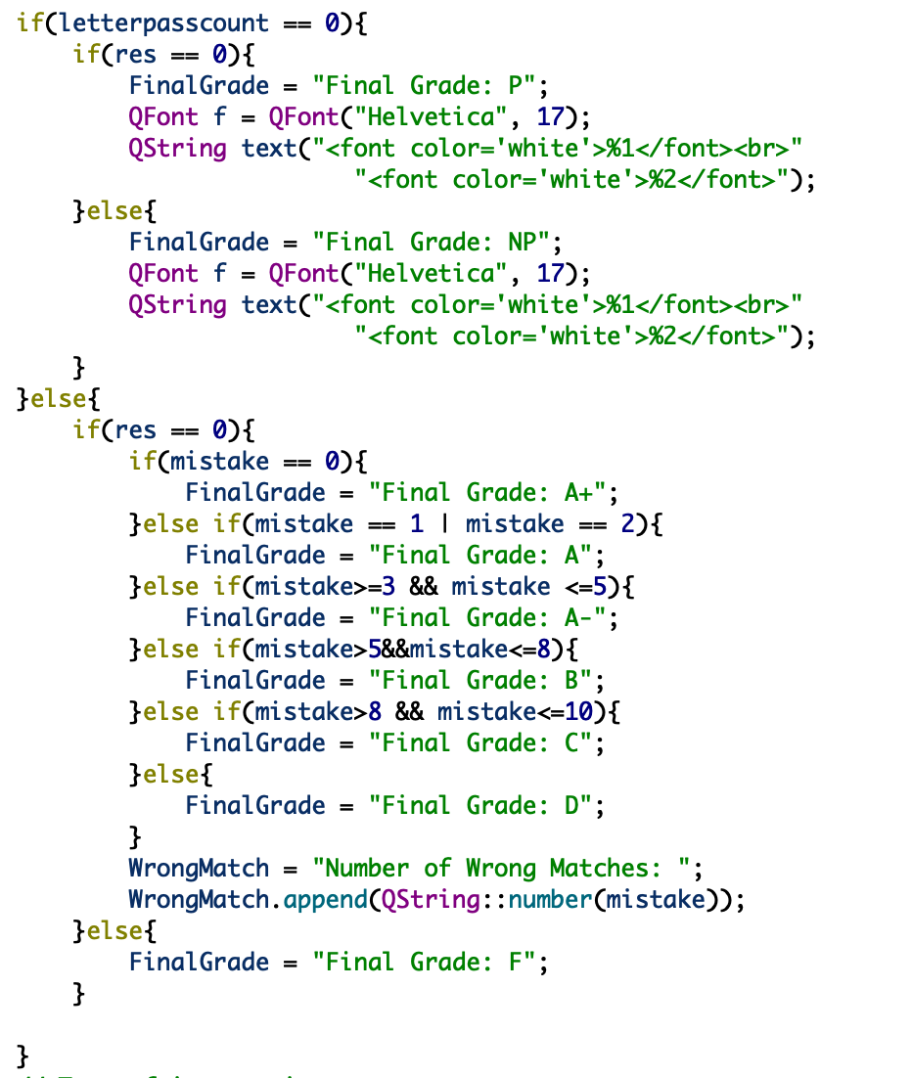
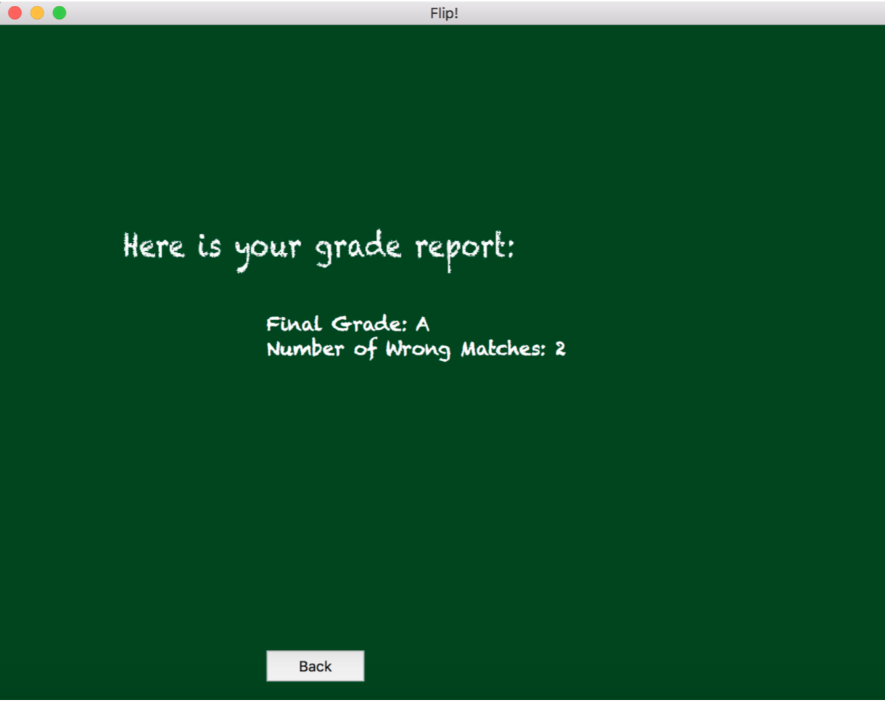
Class: grade

Slide 12
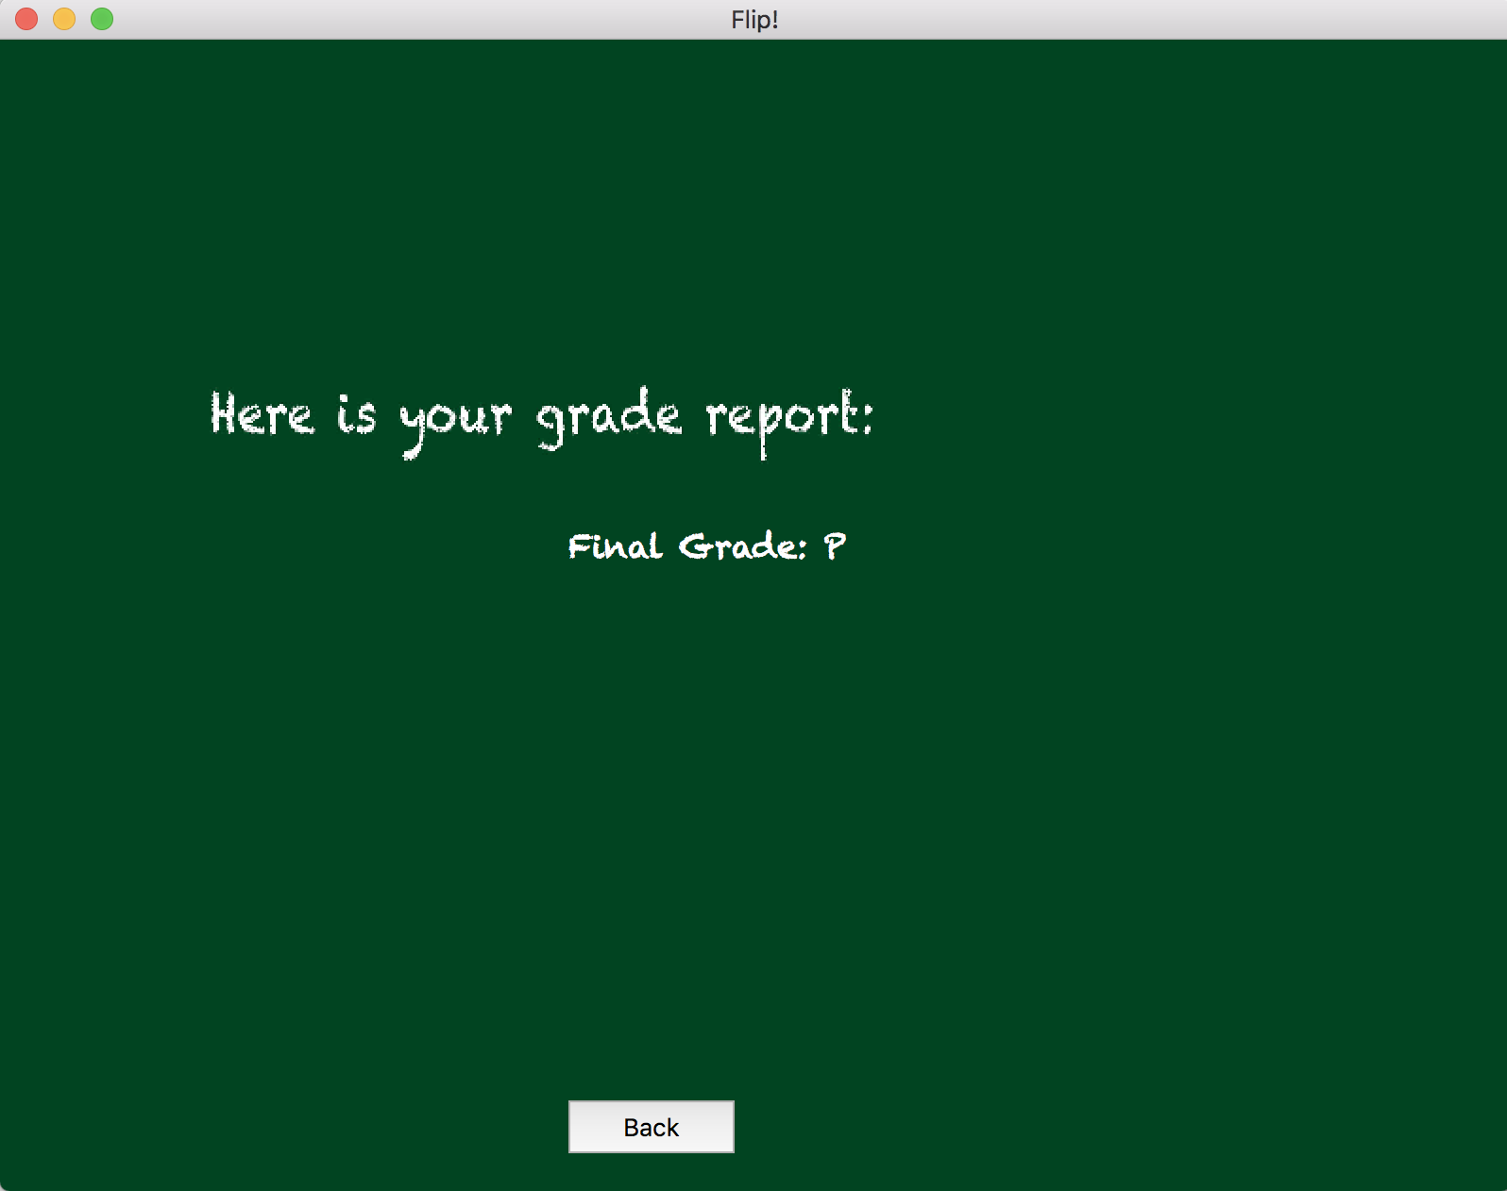
Class: grade

Slide 13
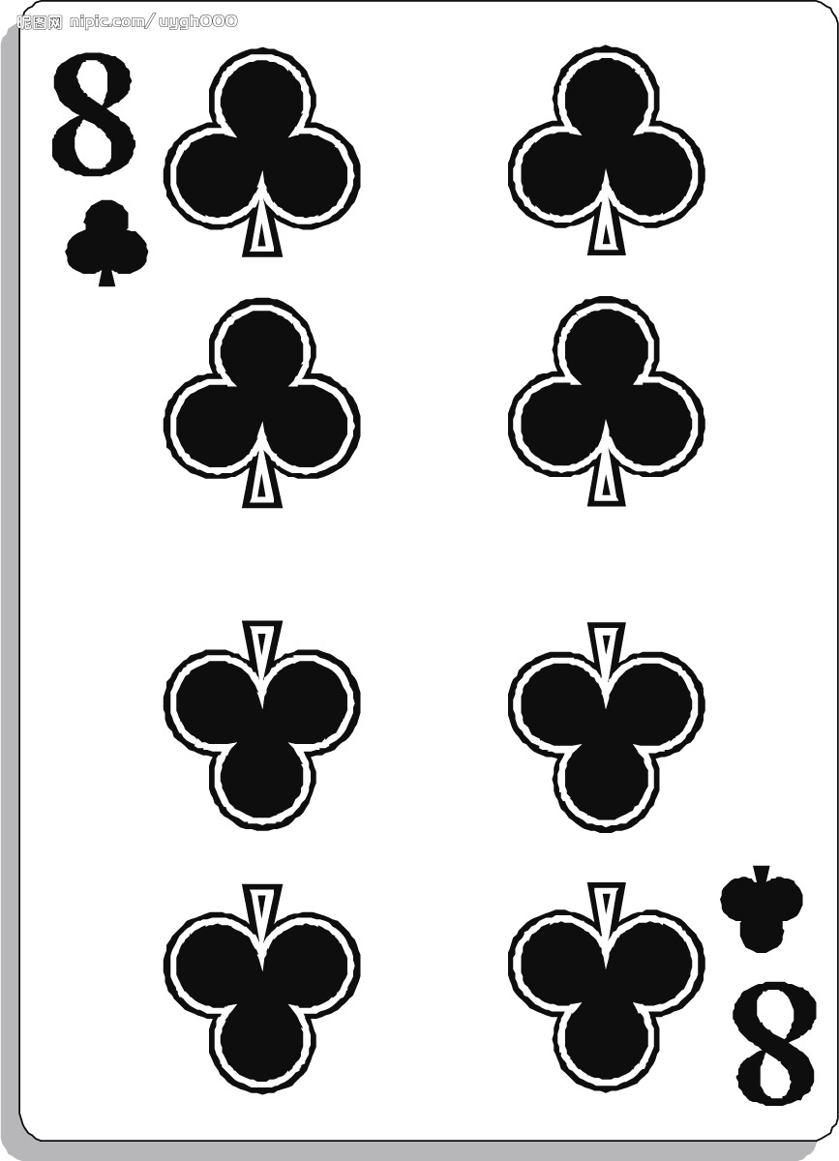
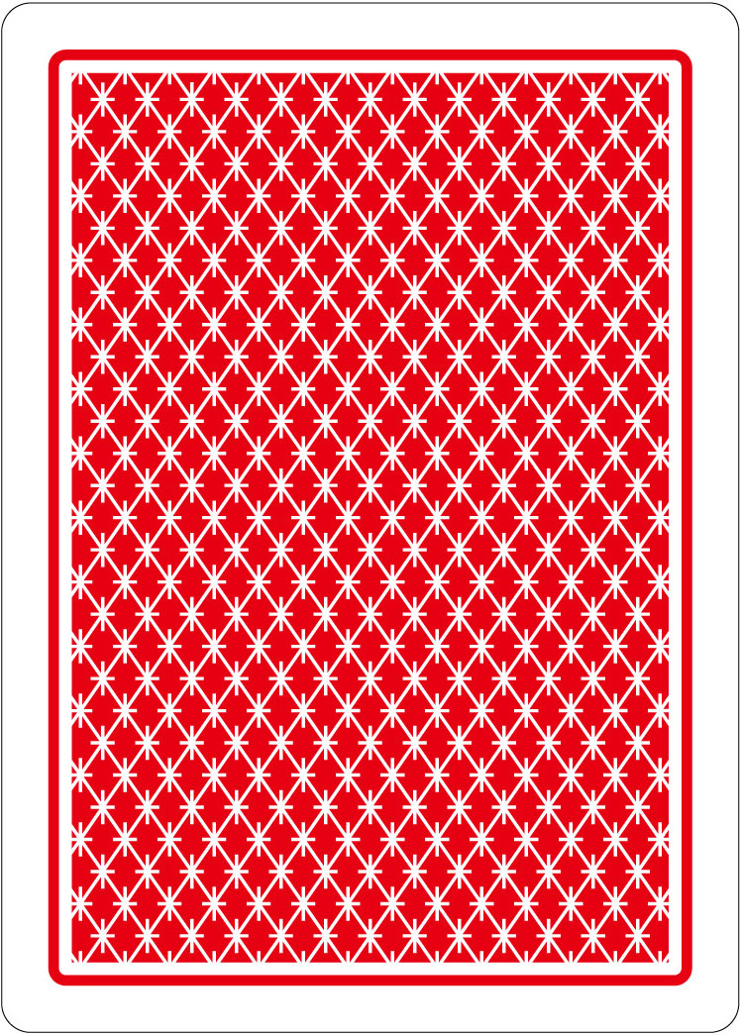
Class: card
QWidget
card
front image
Private Variables back image
state
void shake()
void reveal()
Member Functions void hide()
void paintEvent()
bool equals(const card& b)

Slide 14
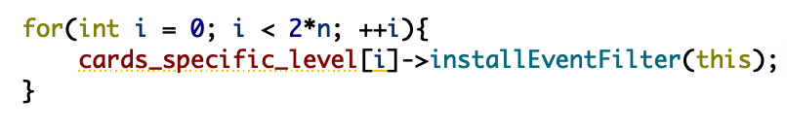
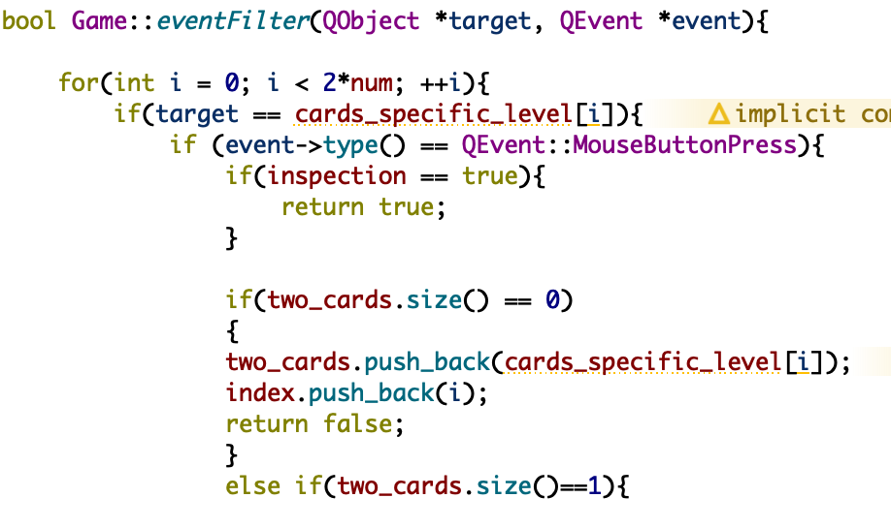
Handling Signals from Card Objects
1. Install Event Filter on each Card Object.
True:
Signal blocked
False:
Signal passed on
2. Define the Event Filter

Slide 15

Any Questions？

